Slide 1

Summary report
Research Team

Slide 2
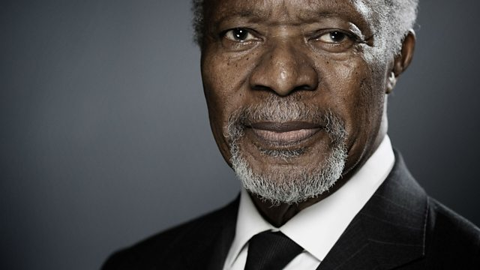
“
To live is to choose but to choose well, you must know who you are and what you stand for, where you want to go and why you want to get there.
Koffi Annan
”

Slide 3

table of contents
01
introduction
04
internal status
02
background
05
eyes in the future
03
external forces
06
Reflex ions & questions

Slide 4
introduction
01

Slide 5
introduction
DETECT-RESPOND-EVOLVE
This work is intended to reflect on the day-to-day organisational activities of our Movement and to try to DETECT the changes that are expected in the coming decades and which may constitute threats or opportunities for WOSM.
This step is crucial to RESPOND to the implications and consequences of future changes. The ultimate goal is to adapt to new realities successfully and to EVOLVE while preserving the values and ideals of Scouting expressed by the Founder.
We should not limit ourselves to listing the trends but to outlining their systemic problems. We have highlighted what we believe are the systemic drivers of Scouting's future.
The challenge of DETECTION is not just about current short-term main trends, BUT it’s also a matter of weak signals and non-linear changes.
section 01

Slide 6
starting point…
introduction
​The world is undergoing rapid transformation, marked by complexity and uncertainty; as part of the global ecosystem, Scouting will be affected…
​More and more citizens are expressing concern about climate change and the effects of pandemics, and in many countries, there are moves towards identarian withdrawal. Social and political polarisation is increasing, and "fake news" is worryingly telescoping with reality. The pace of technological innovation, its impact on everyday life, and even the definition of the human being are unprecedented.
​These factors will be amplified or mitigated by demographic changes, shifts in global power and probably other key factors. Behind the global trends, national and regional dynamics are evident.
​The projections that we have been able to collect are generally based on phenomena or current realities. The fact remains that unforeseen innovations or events may prove central in shaping the world. These disruptive elements must never be removed from our society monitoring field.
section 01

Slide 7
background
02

Slide 8
cross-analysing
methodology
External
According to the research team's terms of reference, we have developed a cross-case analysis of WOSM's past and future regarding internal and external factors.
We have discarded the analysis of external factors from the past to optimise the time available!
The aim is to provide a complete understanding of WOSM's performance and potential and help develop effective long-term success strategies.
external forces
Future
Past
internal status
eyes in the future
Internal
section 02

Slide 9

methodology
Three sources of information:
For the external analysis,
We identified some substantial reports and studies conducted by a panel of intergovernmental, governmental and private institutions and academic research, plus responses from specific focus groups.
For the internal analysis,
We gathered feedback and thoughts from several stakeholders through focus groups and explored internal documents and data provided by the World Bureau.
section 02

Slide 10
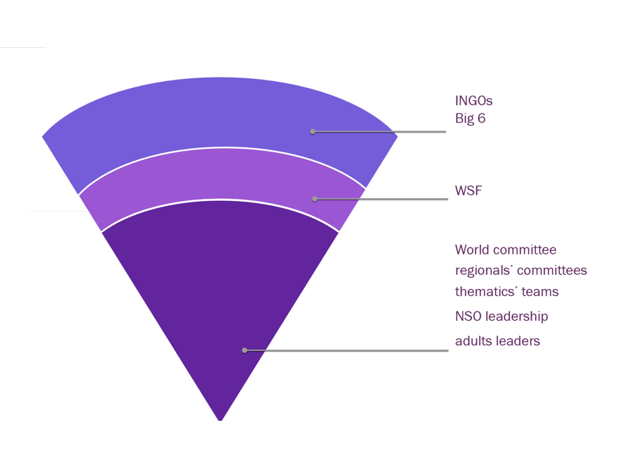
methodology
A reflection on our strengths and challenges, our ambitions and doubts, can only be done with the involvement of a representative sample of our stakeholders.
It is crucial to take into account not only the factors but also the actors to succeed in this project.
Starting from the primary beneficiaries, the young people, and adult leaders through the NSOs, the organisation's teams, the governments, our major partners, the WSF and the members of the Big 6.
section 02

Slide 11
external forces
03

Slide 12
megatrends
climate impact & resources stress
demography & social changes
ubiquitous technology
economy, inequality & labour shift
rapid urbanisation
interconnected politics & new forms of governance
a.

Slide 13
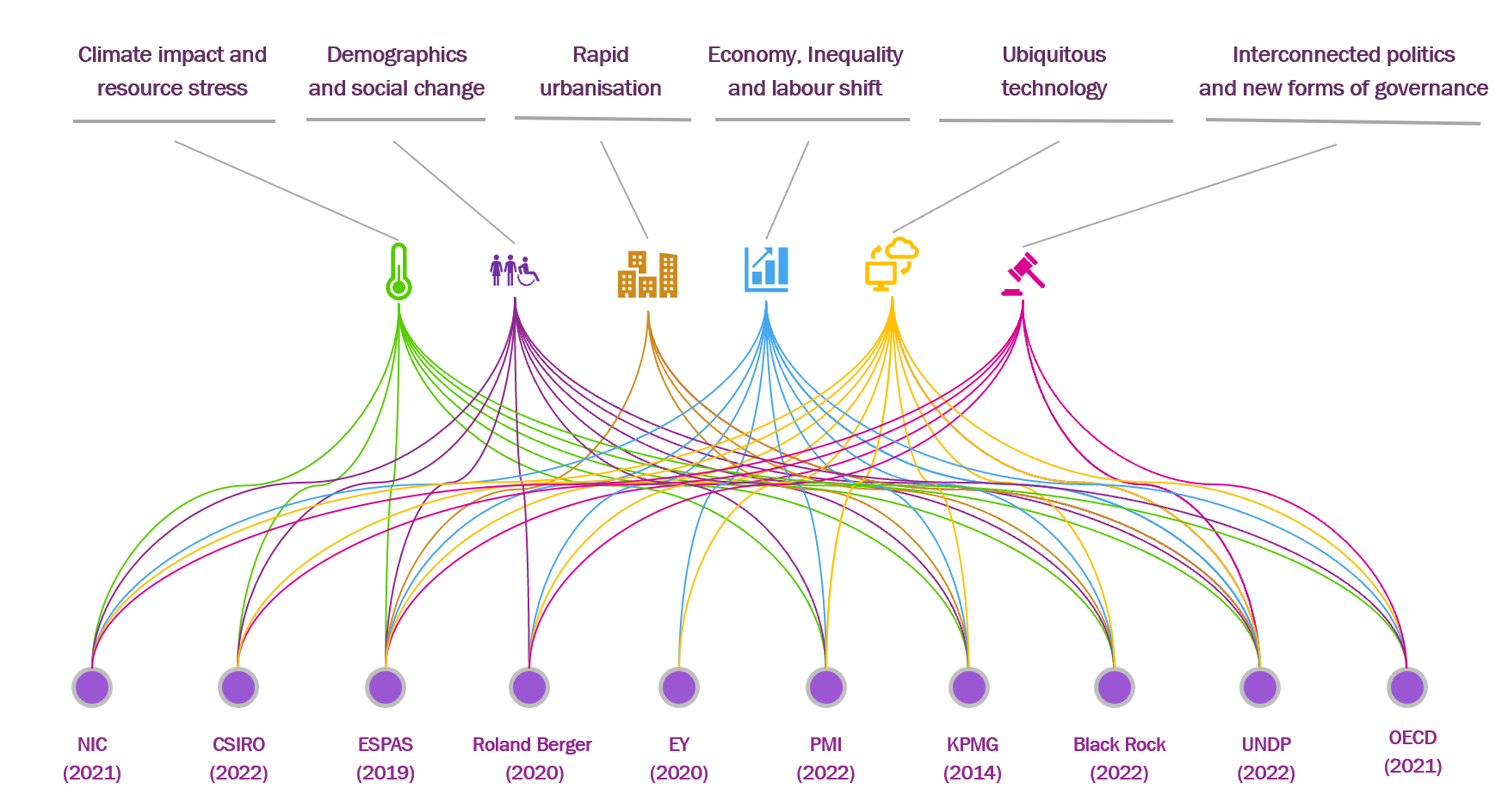
a variety of analytical models
megatrends
There is no "universal" list of the main drivers of change. While demographics, climate change and technology seem unavoidable, other factors are considered by some authors rather than others. We cannot claim to be exhaustive of the factors that could impact our future. The drivers selected are the most recurrent and, according to the sample of institutions we analysed, the most influential.
section 03

Slide 14
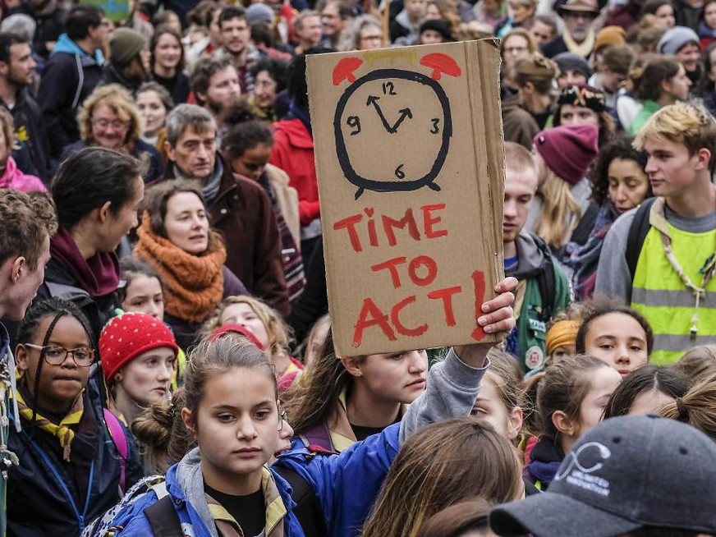
i. climate impact & resources stress
40% of adults worldwide have never heard of climate change
Nature Climate Change (2015)

Slide 15
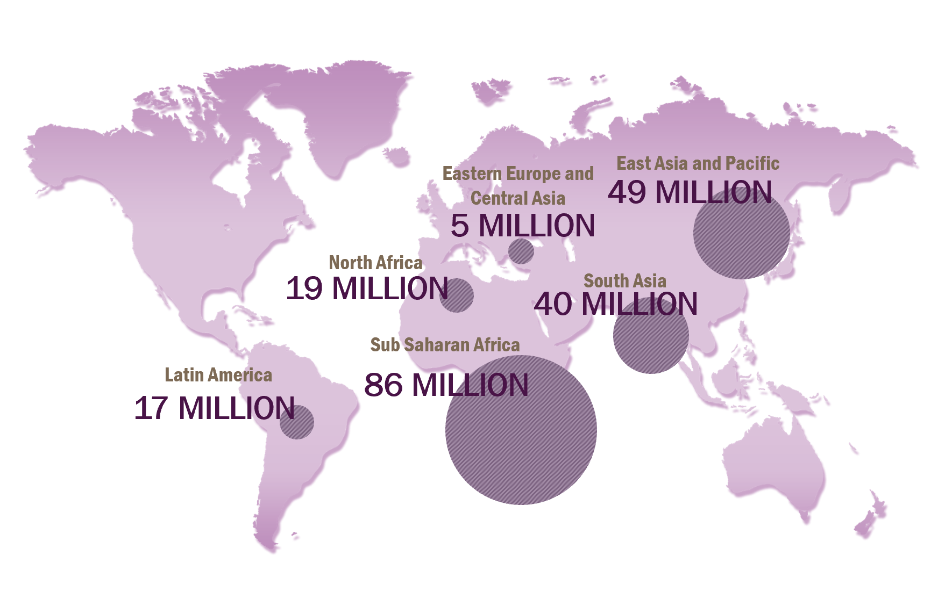
the Groundswell report
Internal climate migration
By 2050 –without concrete climate and development action- climate change could lead more than
216 MILLION PEOPLE
In 6 regions to migrate within their own countries.
section 03
World Bank. https://openknowledge.worldbank.org/handle/10986/36248

Slide 16
climate change
Climate change is expected to continue to have significant impacts on the planet in the coming decade:
Ecosystems: this may include more frequent and severe weather events, rising sea levels, and other environmental challenges.
Economies: reduced agricultural productivity, increased health costs, infrastructure damage and disruption, energy system disruption.
Societies: increased poverty and inequality, food and water insecurity, displacement and migration, health risks.
​Climate change may also lead to the following:
Economies by increasing focus on sustainability and renewable energy, developing a climate-resilient infrastructure and ecosystems and improving public health.
Social opportunities and social justice, by building resilience and a new community contract based on fair distribution, across societies, of benefits and costs of climate action.
How scouting …?
Will contribute:
To projects delivering improvements for the environment.
To change people's mindsets.
Will integrate
Sustainability practices into every function and activity (recycling, single-use plastics, …) on the individual, national, regional and global levels
section 03

Slide 17
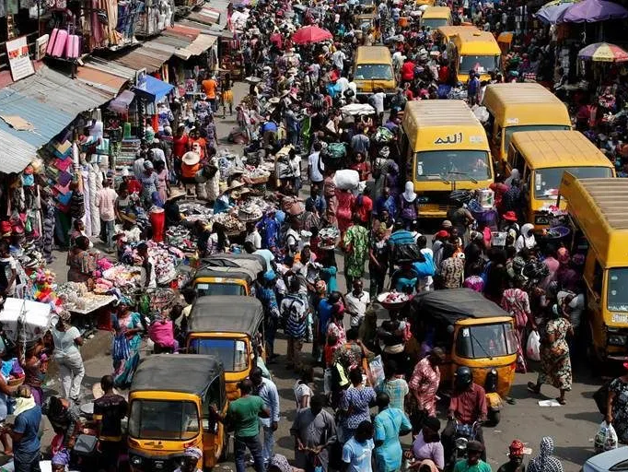
ii. demography & social changes
9.7 billion by 2050
United Nations
Department of Economic and Social Affairs Population Division

Slide 18
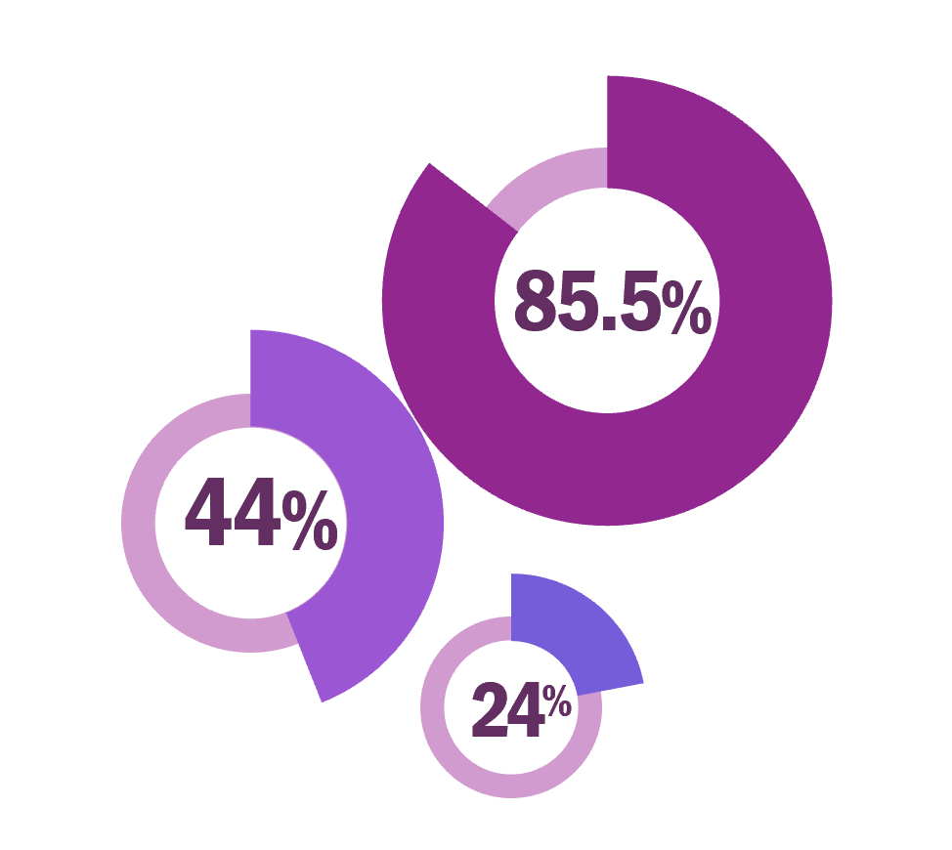
average population growth rate
Africa
Countries | 2022 | 2050
Democratic Republic of the Congo | 99 010 216 | 217 494 000
Ethiopia | 123 379 930 | 214 812 300
Nigeria | 218 541 220 | 377 459 870
The United Republic of Tanzania. | 65 497 750 | 129 931 530
Arab
Countries | 2022 | 2050
Egypt | 110 990 100 | 160 339 890
Asia-Pacific
Countries | 2022 | 2050
India | 1 417 173 100 | 1 670 490 600
Pakistan | 235 824 860 | 367 808 480
Philippines | 115 559 010 | 157 891 620
A challenge or an opportunity?
More than half of the projected increase in global population up to 2050 will be concentrated in just eight countries.
.
section 03

Slide 19
demography
Population growth, aging, migration and the changing age structure will have significant implications for societies and economies around the world. These trends have important implications for resource availability. Education and healthcare systems, labor markets, and social and economic development will be challenged.
Aging population:
Will lead to increased demand for healthcare services and long-term care facilities. will also have implications for workforce participation, retirement savings, and government budgets.
Youth bulge:
Will presents both opportunities and challenges for those countries. On the one hand, it offers a potential demographic dividend if young people are given adequate education and employment opportunities. On the other hand, if young people are not able to find work, it could lead to social unrest and political instability.
Declining fertility rates:
Will lead to challenges such as labor shortages, decreased economic growth, and changes in family structures.
Immigration:
Will lead to political and social tensions.
Diversity:
Will likely impact social and political structures, as well as consumer behavior and cultural norms. It may also lead to increased social tension and conflicts.
How scouting …?
Will contribute
To promote sustainable development, social inclusion, and economic growth.
To advocate for universal access to quality education and health care and equitable access to resources and opportunities.
section 03

Slide 20
Social changes
INCREASED DIVERSITY AND INCLUSION
There is a growing recognition of the importance of diversity and inclusion in societies around the world. This includes efforts to address discrimination based on race, sexuality, and other factors, and to promote equal opportunities for all.
Gender roles are changing in many societies around the world, with increasing numbers of women participating in the workforce and taking on leadership roles. This trend is also leading to debates about gender equality, family structures, and social norms.
Mental health is becoming an increasingly important societal trend, with rising rates of depression, anxiety, and other mental health conditions around the world. This trend is leading to increased awareness about the importance of mental health, and efforts to address the root causes of mental health problems.
MULTIPLE IDENTITIES
People all over the world turn to like-minded groups for community and a sense of security. Many gravitate toward more established identities, such as race and nationalism. As established identities grow in importance, a social polarization is increasing and likely will continue to grow with inequality.
RELIGIONS
Continues to play an important role in people's lives, shaping what they believe, and who they trust. In developing regions with the fastest population growth, there is increased religious participation. (Religious populations worldwide is projected to be 23 times larger than the growth of the unreligious between 2010 and 2050).
RISING PESSIMISM, DISTRUST
Global and local challenges are increasing perceptions of social insecurity and pessimism about the future.
section 03

Slide 21
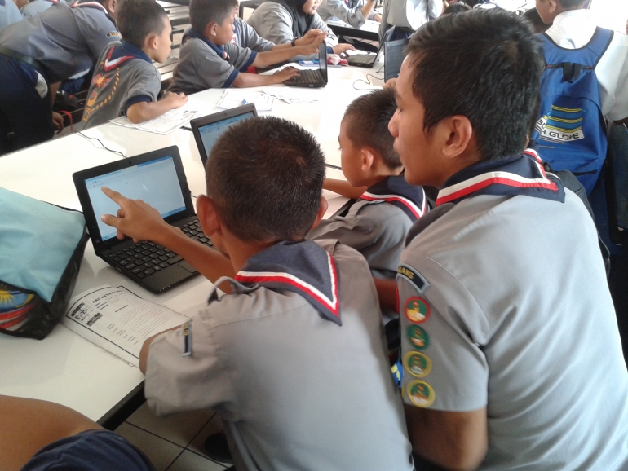
iii. ubiquitous technology
1.4 million educational connected devices by 2030
https://www.statista.com

Slide 22

Internet penetration by region* (jan 2022)
technology
100%.
50%.
25%.
60%
of the world population
* Number of users compared to the total population.
section 03
Digital 2020: Global Digital Overview — DataReportal – Global Digital Insights

Slide 23
technology
Digitalisation will continue to invade a wide range of human activities; this translates into technical and economic changes and many social changes.
Technology, economy, society
IT infrastructures make our modern society work. ICT is being used to build new intelligent networks, medical infrastructures, forms of industrial logistics and production (Progressive automation and Industry 4.0), rapid changes in the world of services, and work in general (labour market).
The virtual (metaverse) will offer more and more possibilities for discovering and developing one's skills,
Behind all this are algorithms and huge amounts of data, which bring great potential, but also social challenges, such as:
The ethical issues:
of learning systems, "digital divide issue";
human enhancement
Governance of and by algorithms.
Psychological risks of the telescoping between reality and the virtual, the real and the false, between one's "real" identity and one's avatar.
How scouting …?
Will have to reflect on how to responsibly manage the developments of digitalisation and the transformations they imply.
Will have to reflect on the risks of exclusion of a part of the membership.
section 03

Slide 24

iv. economy, inequality & labour shift
The future of work is now.
Digitalisation and globalisation have sparked radical shifts in how we live and work.
OECD, What is the future of work?

Slide 25
Changes in the global economy will accelerate over the next decade.
Economic leadership will fall to innovative states that successfully manage the transformations inherent in the workforce.
Some changes that will occur over the next decade are continuing known trends. Many countries will experience significant changes, such as the shift from manufacturing to services and digital trade.
In the coming decades, sub-Saharan countries may have a demographic window of opportunity to reduce poverty. If the arrival of 160 million young people on the labour market between 2010 and 2030 can accelerate economic growth. But this "demographic dividend" is conditional on a fall in their fertility rates.
section 03

Slide 26
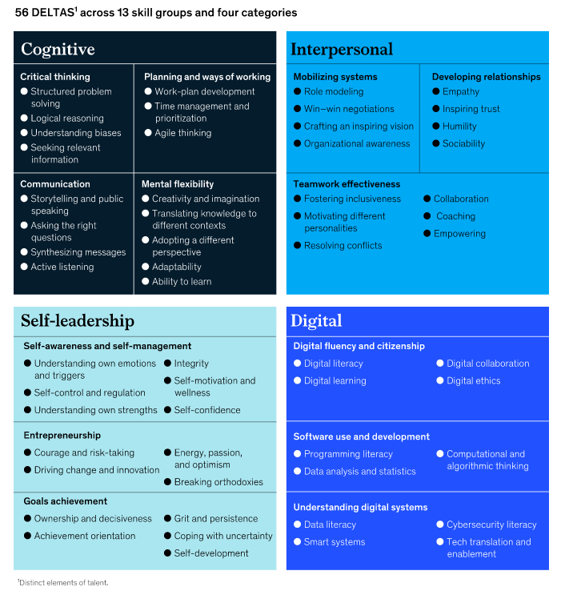
Foundational skills in the future of work
McKinsey & Company
https://www.mckinsey.com/industries/public-and-social-sector/our-insights/defining-the-skills-citizens-will-need-in-the-future-world-of-work

Slide 27
economy
Economy continues to be an engine of development. However, the current models are being questioned and new ones seem to emerge:
New activities & products: the focus on sustainability and the lack the resources, as well as the boost on technology, are creating a new set od needs and products and making others obsolete.
Labor force : the high speed of change in activities and products demand for new types of skills and knowledge. Many people need to transition to a new work ethos and need to update their competences. Besides, different generations will need to coexist in the workspace.
​Emerging economies (from the global south) seem to have the potential to play key roles in the global economy. Increased economic dynamics are expected in these countries, although this can come with social inequalities.
Nature of work: the “job for life” is an outdated concept. Work seems to be much more oriented to results and shorter-term assignments, many of them possible to be carried in any part of the world.
New form of organisations: the hierarchical structure tends to be replaced by a more flexible and fluid one, in which teamwork, autonomy and responsibility are highly valued
How scouting …?
Will contribute:
To develop personal resilience, creativity, and 21st century skills.
To enhance autonomy, sense of responsibility and spirit of initiative.
Will integrate
Flexibility and new forms of organisation
section 03

Slide 28
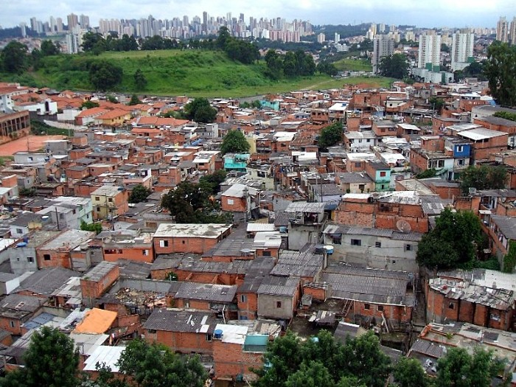
v. rapid urbanisation
Over 60% of the land projected to become urban by 2030 is yet to be built.
Fact sheet – ecosoc – UN (2014)

Slide 29
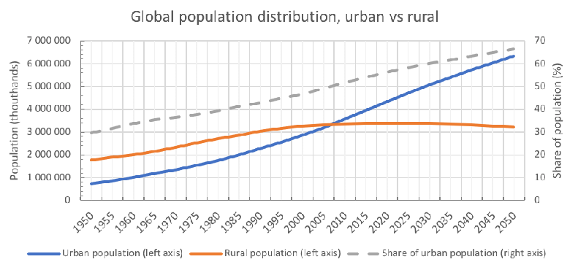
Urban vs Rural population
Since around 2010 more than 50% of world population lives in urban areas. The forecast is that this percentage may rise up to 70% in 2060.
Saez Reale, Alejandro. (2019). Walkability as a sustainable urban public policy.
section 03

Slide 30
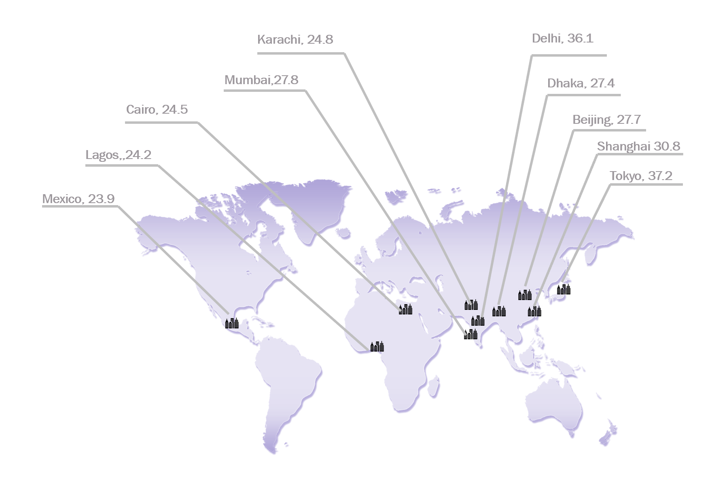
Urban population 2025
urbanisation
This increase is less because there are more cities but due to a strong movement of agglomeration of people in search of opportunities, security, jobs, access to infrastructures, and better quality of life.
Therefore the cities are becoming bigger, in size and population, specially in the developing world, raising a number of additional challenges.
In millions
section 03

Slide 31
urbanisation
Urbanisation has the potential of raising or increasing several individual and collective challenges:
Inequality: the movement of people towards cities doesn’t always bring the opportunities that they are looking for: lack of housing or lack of jobs, may rapidly lead to poverty and other problems that weakens the social fabric
Resources: the agglomeration of people requires more resources (food and goods, water, energy, space). Awareness and creativity in the use of resources will be a requirement.
How scouting …?
Will contribute:
To address the social, environmental and economy challenges happening in an urbanized environment.
To people’s well-being in a potentially more competitive and demanding life.
Will integrate:
A predominant urban way of life in its practices which has nature as a favorite educational setting
Waste & pollution will tend to grow; New patterns of consumption and production are needed
Well-being: to live in a demanding and stressful environment will pose several challenges in terms of health and quality of life
Stress over infrastructures and services will be a reality, caused not only by the amount of people but also by the effects of natural disasters. Urban resilience will be a key issue
section 03

Slide 32
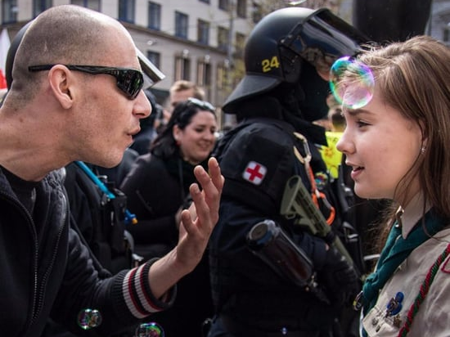
vi. interconnected politics & new forms of governance
More than 50%
of the world’s population has lived in direct contact or proximity to significant political violence
(In the past 15 years).
A New Era of Conflict and Violence | United Nations

Slide 33







factors impacting geopolitics
politics
Changing demographics and migration
Rise of nationalism and populism
Climate change
Cybersecurity and information warfare
Shifting global power dynamics
Conflicts and wars
section 03

Slide 34
factors shaping the landscape
politics
Governance and political participation:
Boosted also by the access to technologies, new forms of participation are on the rise which lead to other governance settings, more open, responsive and accountable
Rise of nationalism and populism:
Already present in many countries around the world. This trend can lead to increased political polarization, trade tensions, and geopolitical instability.
Shifting global power dynamics:
The global balance of power is shifting. This can lead to tensions and competition between established powers and rising powers, as well as changes in international norms and institutions.
Cybersecurity and information warfare:
Are becoming increasingly prevalent and sophisticated. These threats can undermine political stability and national security, as well as disrupt economic and social systems.
Climate change:
Will be significant challenges to national security, economic stability, and social well-being. Addressing climate change will require international cooperation and collective action.
Changing demographics and migration:
Will lead to challenges such as labor shortages, changes in cultural and social norms, and political tensions over immigration policies.
Conflicts and war:
​This leads:
Long-term economic consequences,
​Changes in the balance of power within international organizations.
Long-term consequences for the region's stability and the world.
section 03

Slide 35
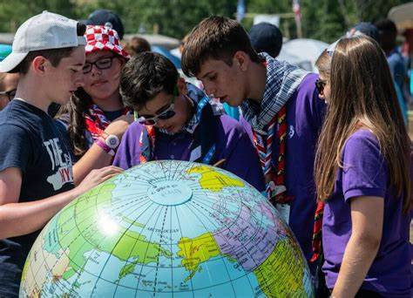


Slide 36
as a wrap up…
When we say that we want to contribute to "creating a better world", we mean that we want to act on both dimensions: the individual and the community. Coherence between personal development and participation in creating, developing, promoting and integrating collective norms is essential for us. The norms and rules that govern a society constitute what we call a social contract.
The concerns raised by the various challenges in the world. The feeling that political and social responses are not up to scratch, dissatisfaction with the lack of opportunities, etc. force us to rethink our role in the new social contracts many call for.
section 03

Slide 37
A new social contract?
as wrap up…
2022 State of the World’s Volunteerism Report (UNV)
A new social contract consists of the following three priorities:
Ensure human rights for all by extending social contracts to marginalized sectors of the society.
Be inclusive and recognize multiple inequalities that act as barriers to the engagement of certain groups—for instance, women—in relationships with the state.
Protect the planet, ecological processes and people’s relationship with nature.
REIMAGINING OUR FUTURES TOGETHER A new social contract for education (UNESCO)
A new social contract for education must reinforce education as a public endeavour, shared social commitment, as one of the most important human rights, and as one of the most important responsibilities of states and citizens. In turn, one of the key roles of education is to educate citizens who advance human rights. This entails building the capabilities that make students autonomous and ethical thinkers and doers. It means equipping them to collaborate with others and developing their agency, responsibility, empathy, critical and creative thinking, alongside a full range of social and emotional skills. To align education with this ambitious vision it is necessary to establish new ways of organizing learning. Education can be considered as one of the central elements for helping humanity achieve peace with one another and with the Earth.
section 03

Slide 38
the views of others
Youth
b.

Slide 39
Diverse youth and diverse perspectives
youth perspectives
....While megatrends impact young people globally, it is important to stress that regional and especially national contexts significantly influence their concerns and vision of their future.
National or regional surveys highlight recurring issues:
employability (opportunities/fears)
poverty
connectivity (access and cost)
education (quality and availability)
social engagement versus political or trade union engagement
lack of confidence in the state’s ability to deal with challenges, and the corruption of the elites
inequality.
section 03

Slide 40
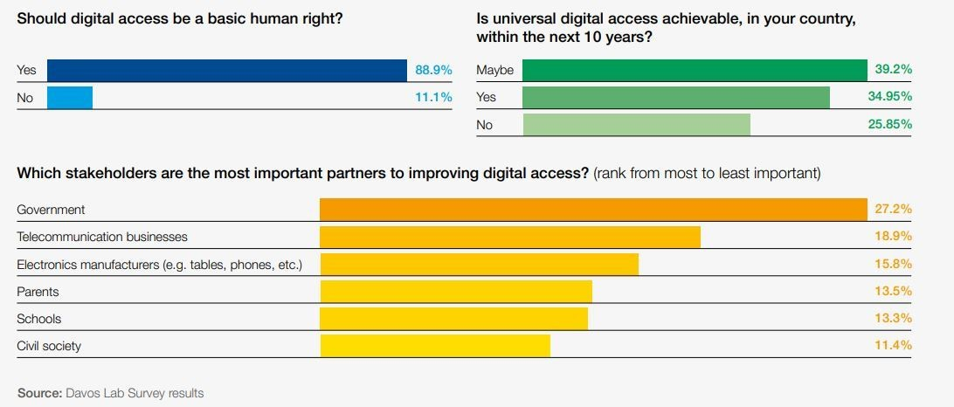
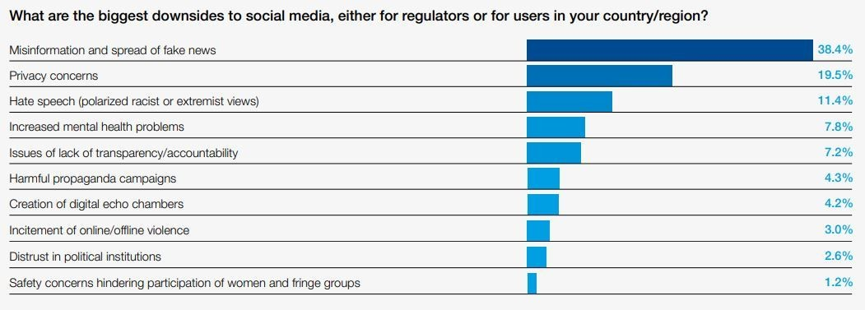
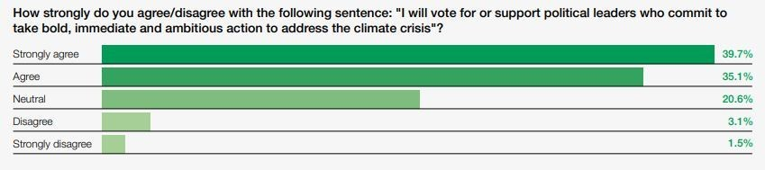
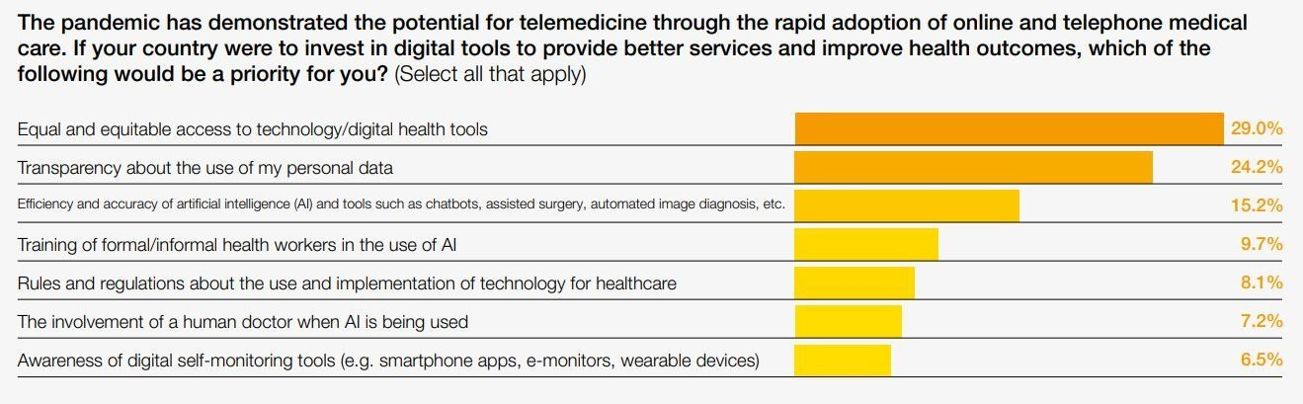
Young people are right to be deeply concerned and angry, seeing several challenges as a betrayal of their future.
youth perspectives (World Economic Forum – report 2021)
Conscious consumerism Incentivize sustainable consumption and penalize production that’s not All stakeholders to take urgent action to safeguard nature and future food production. | 2. Digital access $2 trillion Digital Access Plan to increase global internet connectivity to over 80% Telecoms to provide affordable data priced at no more than 2% of monthly GNI per capita | 3. Digital literacy: Tackle misinformation Tech companies to be transparent about misinformation and its spread on their platforms Capacity-building programmes and education to help citizens better identify fake news. | 4. Democracy with a future Strengthened laws against media monopolies to protect democratic freedoms. Capacity-building and incubation programmes to ignite ambitious policy-making. | 5. Inclusive jobs and social safety nets A global wealth tax on assets worth more than US$ 50 million to fight growing inequality Universities to end the exorbitant tuition fees that stifle social mobility
8. Next generation ESG*: Stakeholder capitalism Governments to implement fit-for-purpose policies and regulations on big tech Universities to ensure ESG literacy is integrated into business and tech curriculums. | 7. Net Zero: Limit global warming to 1.5°C Governments to invest in communities most at risk from climate change All stakeholders to ensure accountability for urgent green recovery plans. | 8. Next generation ESG: Stakeholder capitalism Universities to ensure ESG literacy is integrated into business and tech curriculums Companies to integrate technology ethics into the design of their products and services | 9. Equitable access to healthcare worldwide World leaders to safeguard equitable access to tests, treatments and vaccines Companies to drive digitalization in healthcare services to improve patient care | 10. Public safety Increased action against gun violence, including bans on homemade firearms All stakeholders to take a stand to end domestic sexual and physical violence
* ESG stands for Environmental, Social, and Governance
section 03
We asked young people what changes they want for the future. Here's what they said | World Economic Forum (weforum.org)

Slide 41
specific trends
Because they are closer to Scouting, a special look is given to 3 specific domains:
Society
Education
Organisations
c.

Slide 42
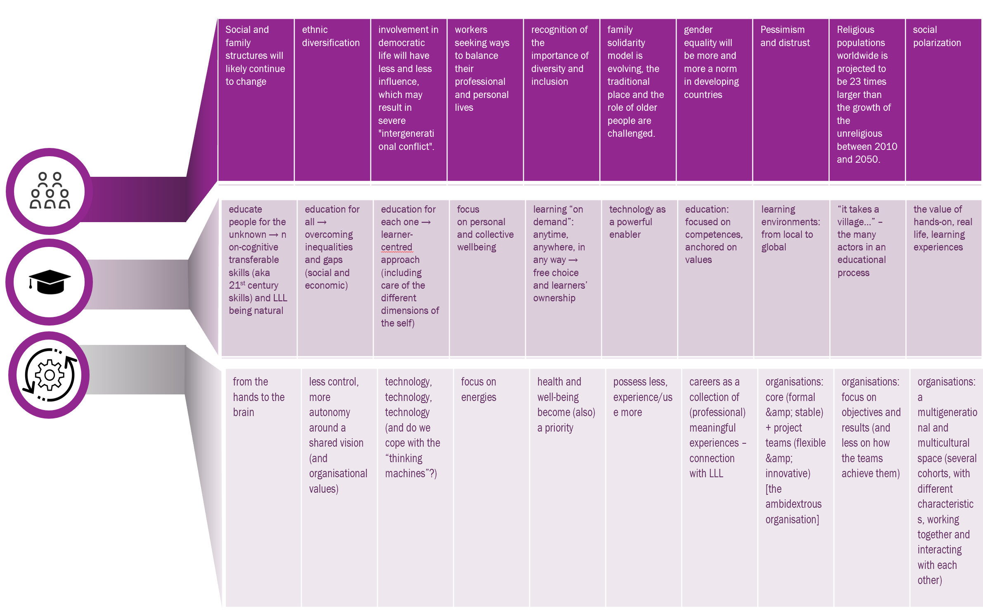
[ society – education – organisation ] – identified trends
section 03

Slide 43
internal status
04

Slide 44
situation analysis
wosm reports
focus groups
a.

Slide 45
WOSM’s membership (2020)
Region | NB of NSO | Membership |  |  | Total WOSM (A) | Total Population (B) | Penetration rate (mean) (C) | r₁ A and B | r₂ C and B
 |  | Median | Min | Max
Africa | 40 | 12 900 | 286 | 2 248 000 | 4 541 353 | 853 86 010 | 3.92 ‰ (σ = 8.17) | 0.41 | - 0.06
Arabe | 19 | 15 470 | 3 185 | 87 081 | 457 442 | 617 277 | 2.82 ‰ (σ = 4.64) | 0.45 | - 0.31
Asia-Pacific | 30 | 39 663 | 575 | 25 166 325 | 33 849 979 | 2 347 706 165 | 12.39 ‰ (σ = 24.93) | 0.77 1* | 0.06 0.06*
Eurasia | 9 | 1 473 | 354 | 2 759 | 12 289 | 197 531 860 | 0.25 ‰ (σ = 0.3) | 0.33 | - 0.39
Europe | 40 | 14 055 | 133 | 504 968 | 1 378 664 | 430 272 069 | 5.34 ‰ (σ = 5.32) | 0.99 | - 0.03
Inter-american | 34 | 1 563 | 198 | 1 599 740 | 2 012 926 | 822 415 909 | 2.3 ‰ (σ = 3.04) | 0.80 | 0.02
A: Census 2020
B: Unpopulation 2020 ( age 5 to 64)
C: A/B
σ : standard deviation
R₁ & r₂ : Pearson correlation coefficient (r, ranges from -1 to 1. A value of -1 indicates a perfect negative correlation, 0 indicates no correlation, and 1 indicates a perfect positive correlation. A value between -1 and 0 or between 0 and 1 indicates a correlation between the variables, with the magnitude of the correlation indicated by the absolute value of r).
*: r without Indonesia.
Population & Growth
Data suggests a correlation between the size of NSOs and the population of countries; this correlation varies between regions. Still, there is no correlation between the penetration rate of an NSO and the population. Substantial variations even exist between NSAs within the same country.
section 04

Slide 46
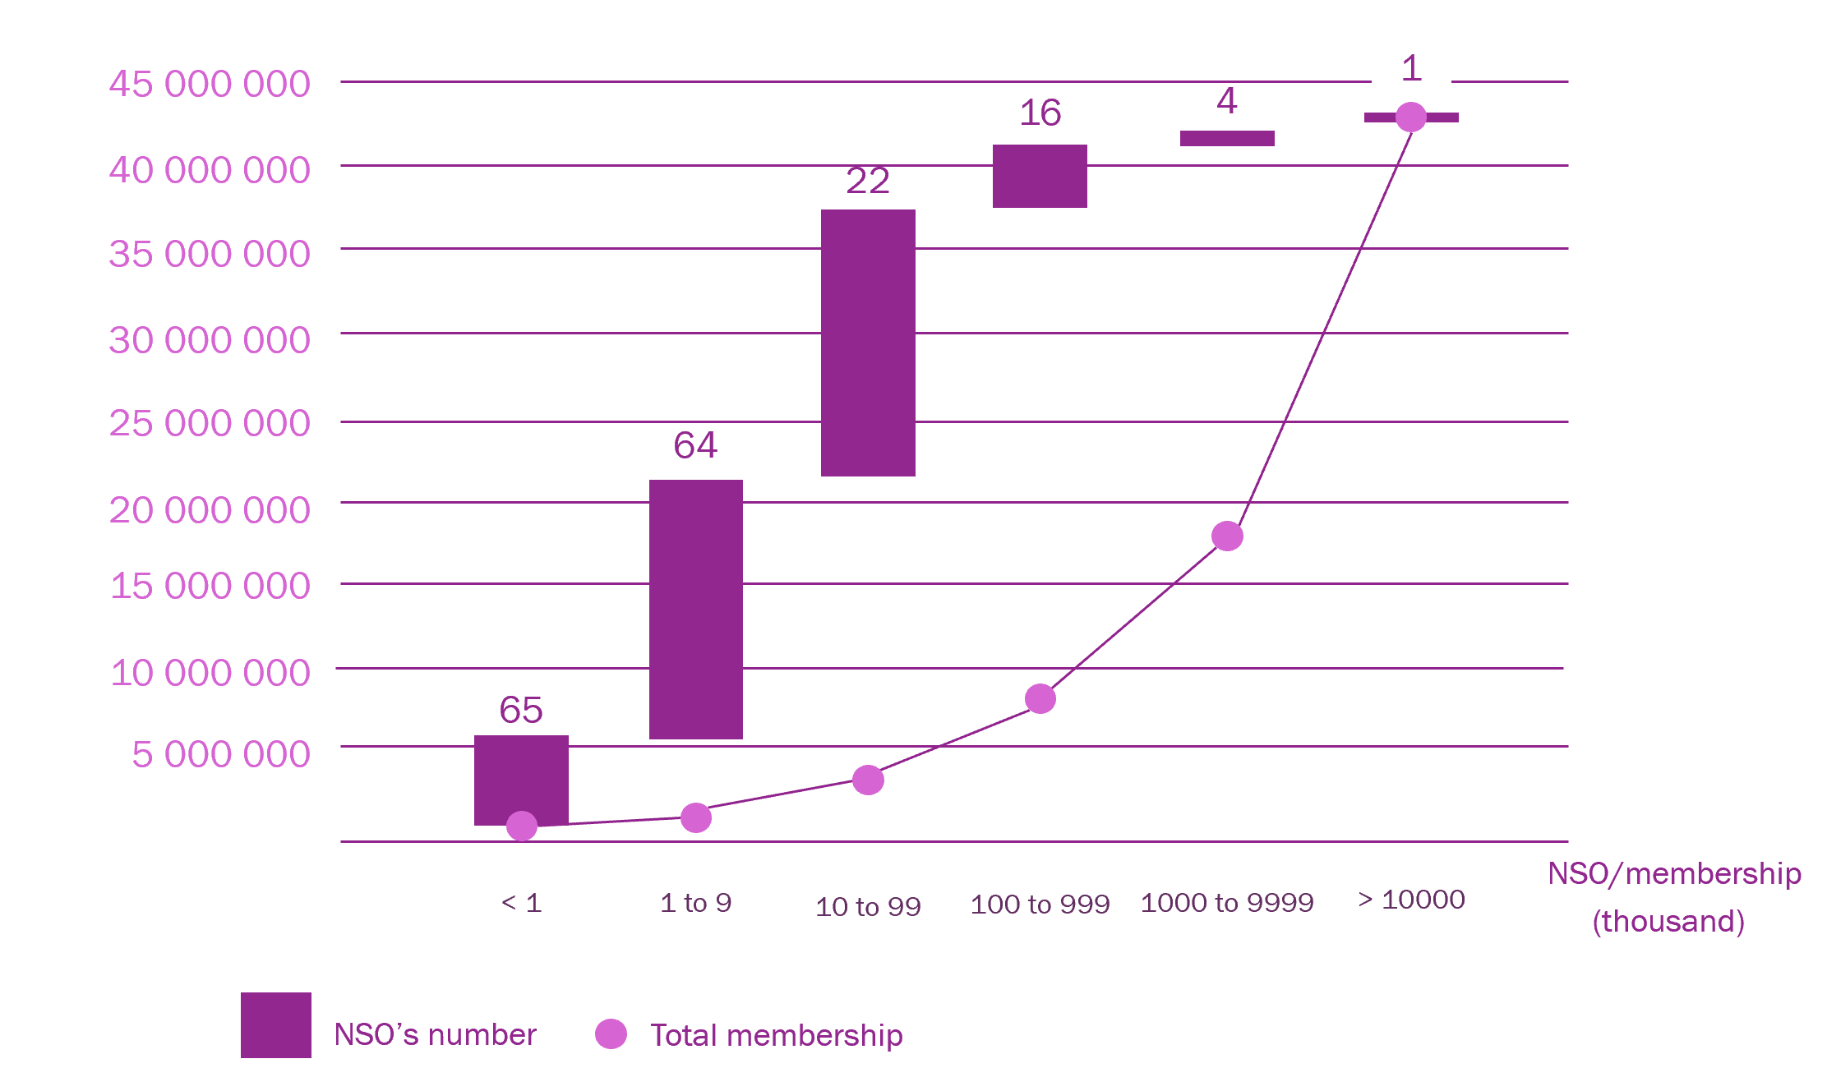
NSOs size & membership distribution
Distribution by the size of NSOs shows that over 87% of the organisations have a membership of less than (100,000), with two main categories emerging. The analysis by region shows different distributions.
Around 151 NSO represents less than 5 million members!
The robustness of data is limited:
Many of our members do not have a reliable system for registering their members or the staff to set up and monitor this activity. The census is declarative. We have seen in the past that considerations (financial or political) influence the data reported to the World Bureau.
section 04

Slide 47
Growth
More and better Scouting should remain at the heart of our thinking. The reasons for growth or lack of growth depend on internal and external factors. The models: Scouting in schools, and community Scouting, are not impacted in the same way (e.g., school closures during the pandemic). Financial, technical and human resources can play a significant role in growth dynamics, but the environment (image, support, etc.) should not be neglected. The growth of some NSAs needs to be better analysed to understand the internal drivers mobilised by these members compared to NSAs in the same country which does not show the same growth. This type of study allows us to neutralise some of the external elements.
It would be interesting to reflect on whether these realities require different strategies from the world level to the regions and from the regions to "NSOs".
section 04

Slide 48



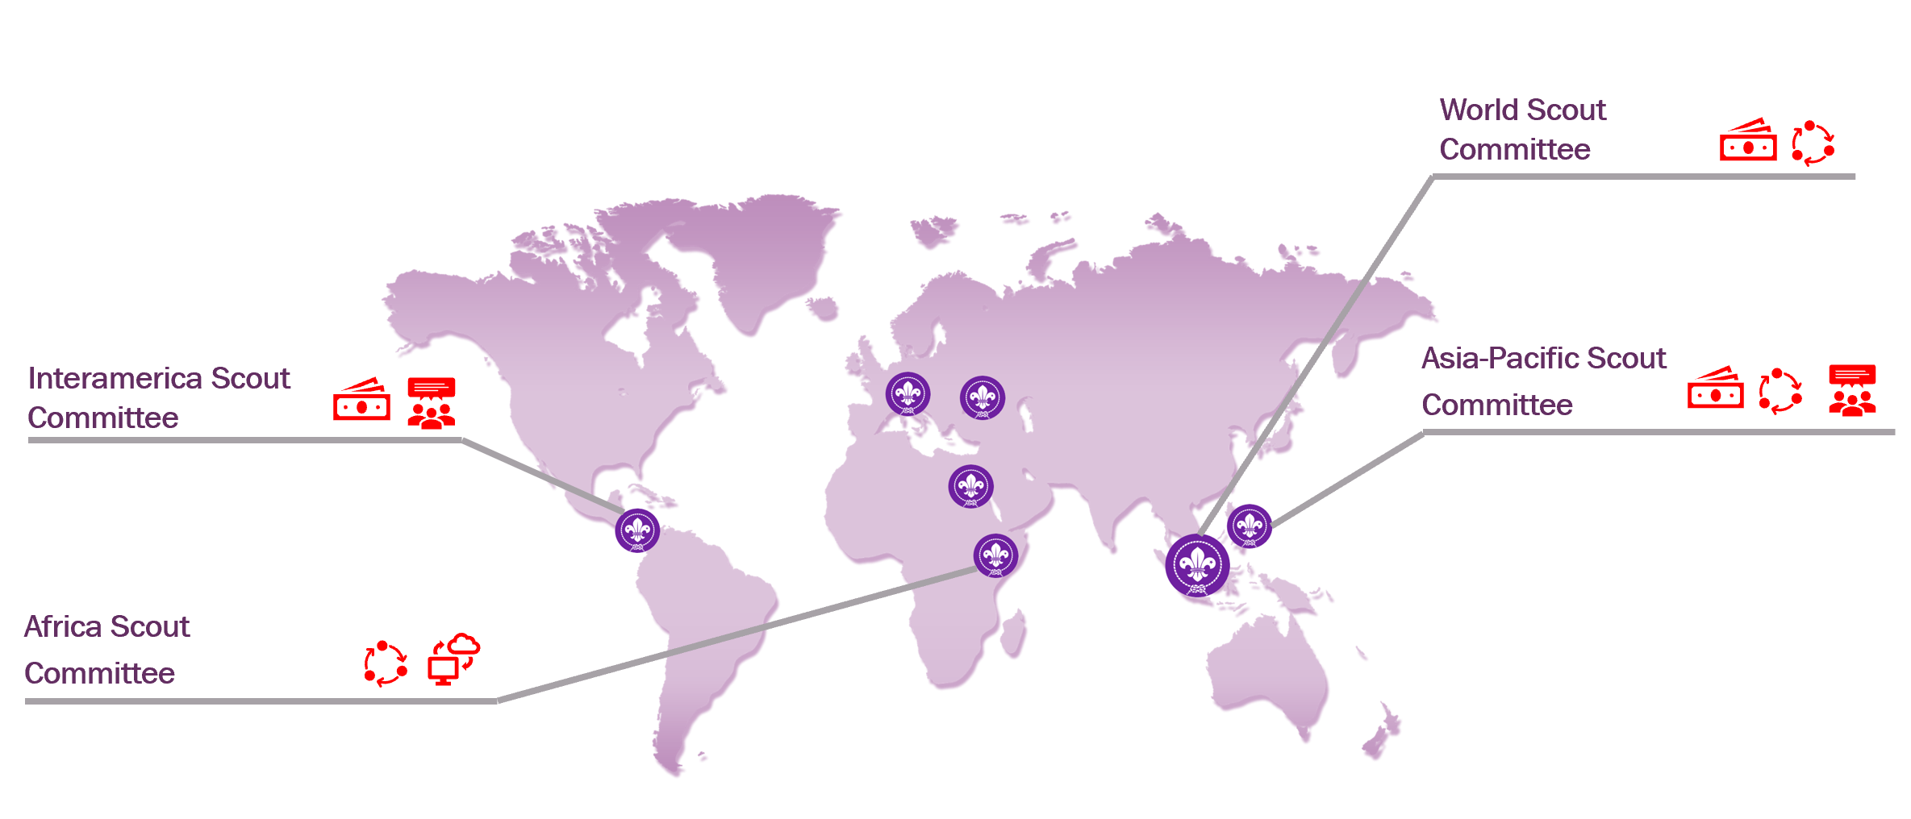

governance challenges
Main challenges
Finances limitations
Process and operation mode
(e.g. HR, internal communication, language)
NSO’s level (e.g. « diversity size, needs, etc » ; focus)
Internet connectivity
The challenges identified by the committees are of various kinds. They have, in one way or another, prevented these governance bodies from being more effective.
Among these elements, we must distinguish the contingency factors (such as the size, the financial situation, the culture of NSOs, external crises, resource scarcity, stakeholders’ agendas etc.), which are imposed on the committees. Others are more specific to the operating methods and the scope of action (language, internet connectivity, digital skills, time availability, etc.).
section 04

Slide 49
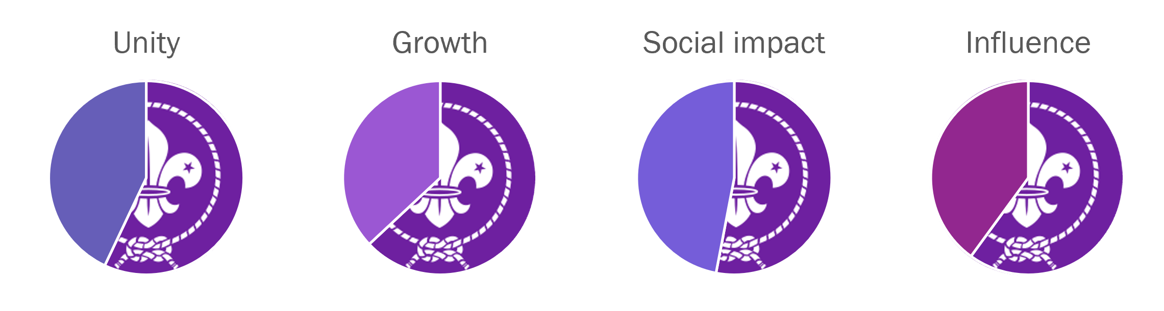
metaindicators
The assessment of governance bodies
The Regional Scout Committees and the World Scout Committee assessed the four meta-indicators. The total scores for each indicator exceeded 50%, and good progress was identified even if there is still work to achieve the objectives fully.
Some verbatims of the committees
Looking at the past there were some active conflicts and I think that get’s down quite a bit in terms of less fighting with each other and more working together to achieve what we want = improvement
The pandemic helps us in the way of exposure. We have the image of being an active organization or better prepared to tackle some difficult situations. At the level of the countries, it helps us being recognize and be more important for our governments.
The humanitarianly issued that happened (Covid-19, climate change etc.) gave us an opportunity to do our best at that time. We were visible, providing humanitarian assistance during Covid, we are active in planting trees which reflect our support on issues of climate.
We had a significant influence as a movement but there are still things which can be done. We started to get to the external audiences and explaining what we do to other people, but we are still not there positioned in the education sector very well.
section 04

Slide 50
elements that need to be improved
focus groups
b.

Slide 51
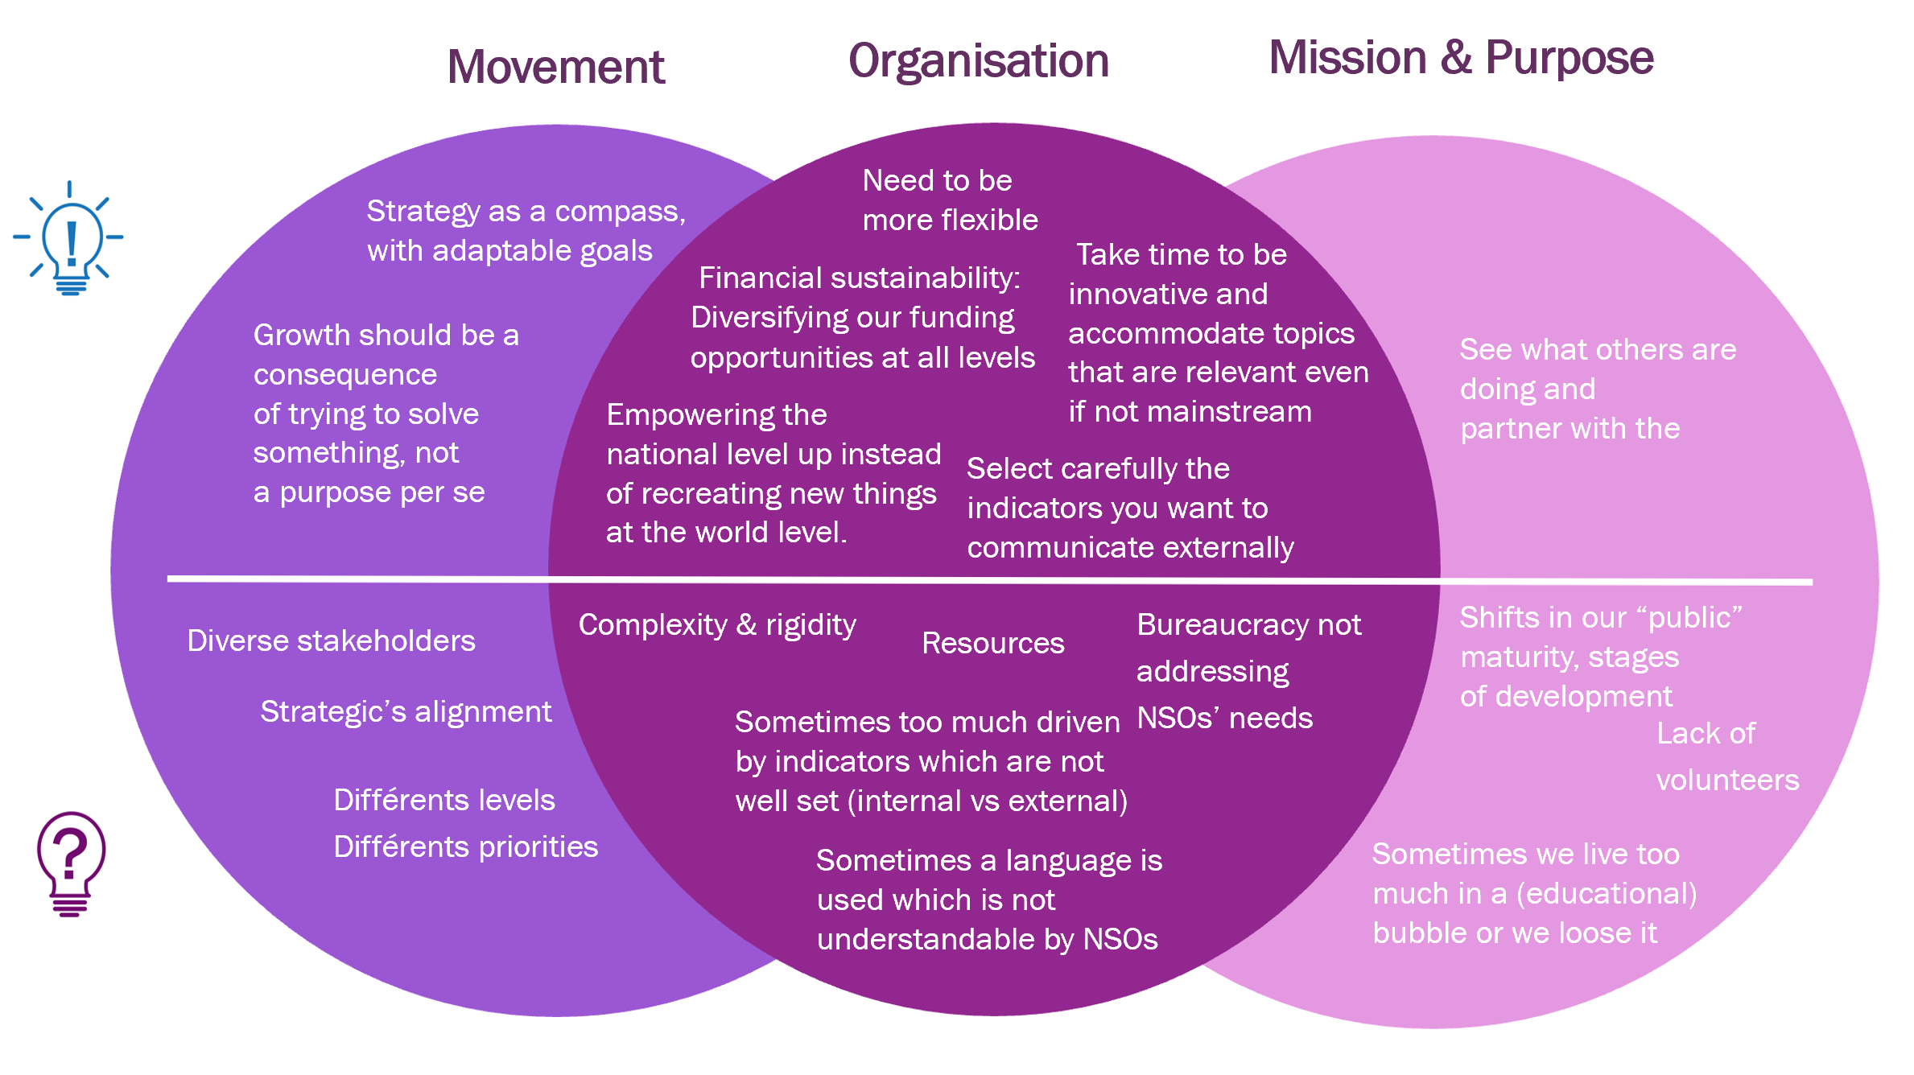
from volunteers (governing bodies and NSOs)
challenges, needs and improvements
section 04

Slide 52
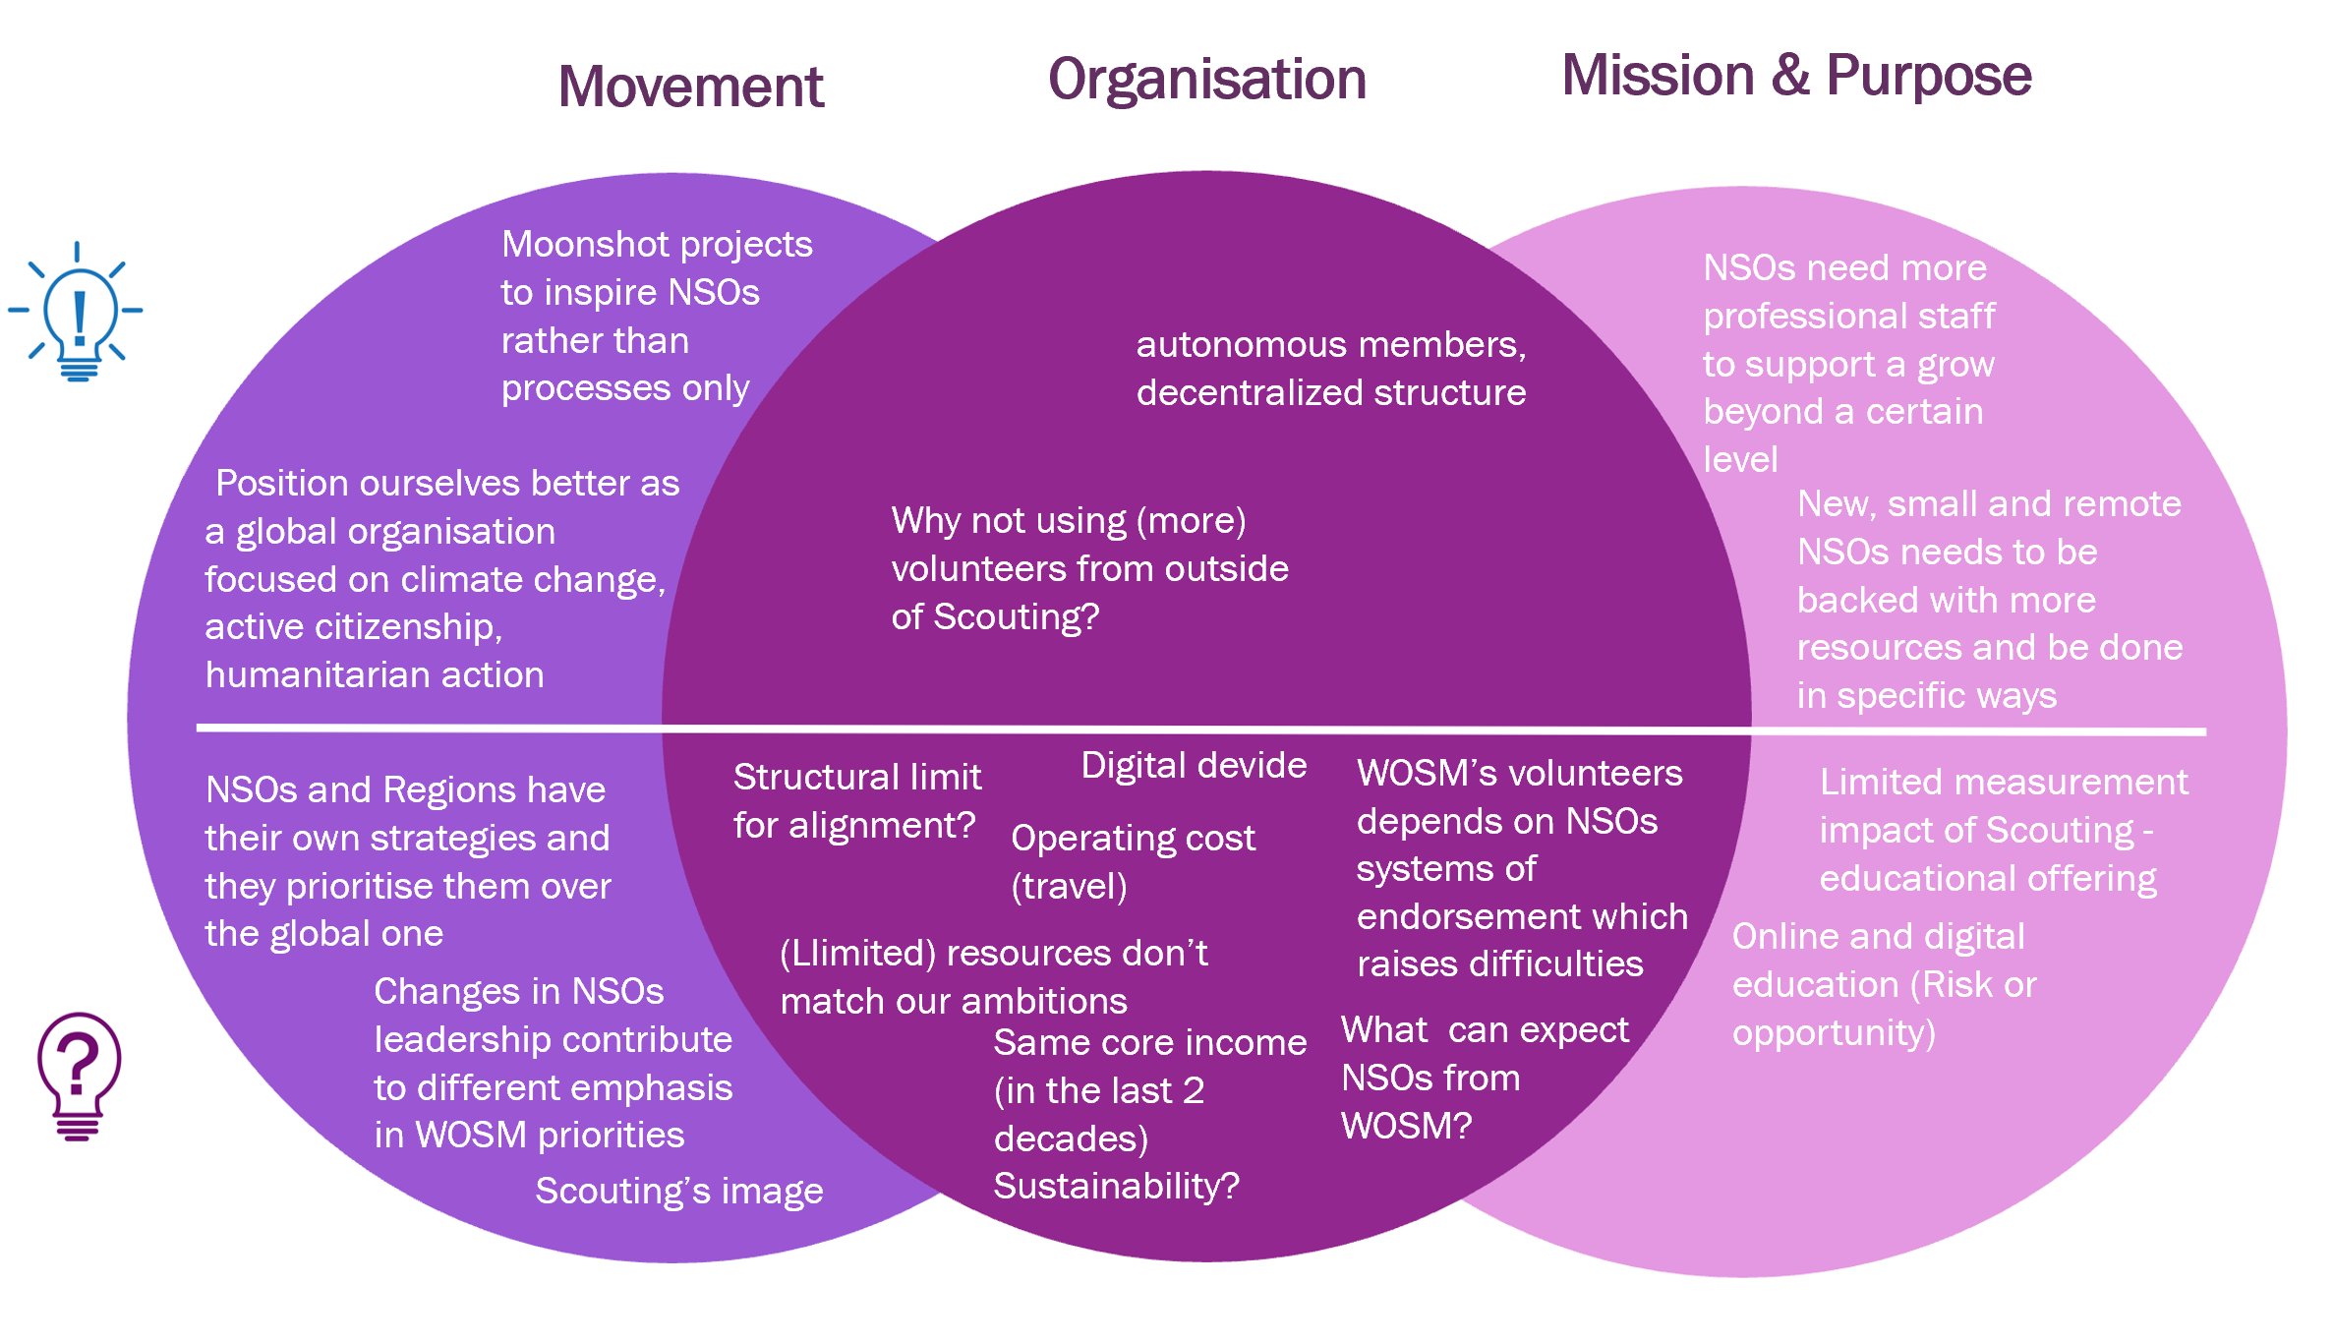
from lead world professionals (SMT)
challenges, needs and improvements
section 04

Slide 53
How do others see us?
C.

Slide 54
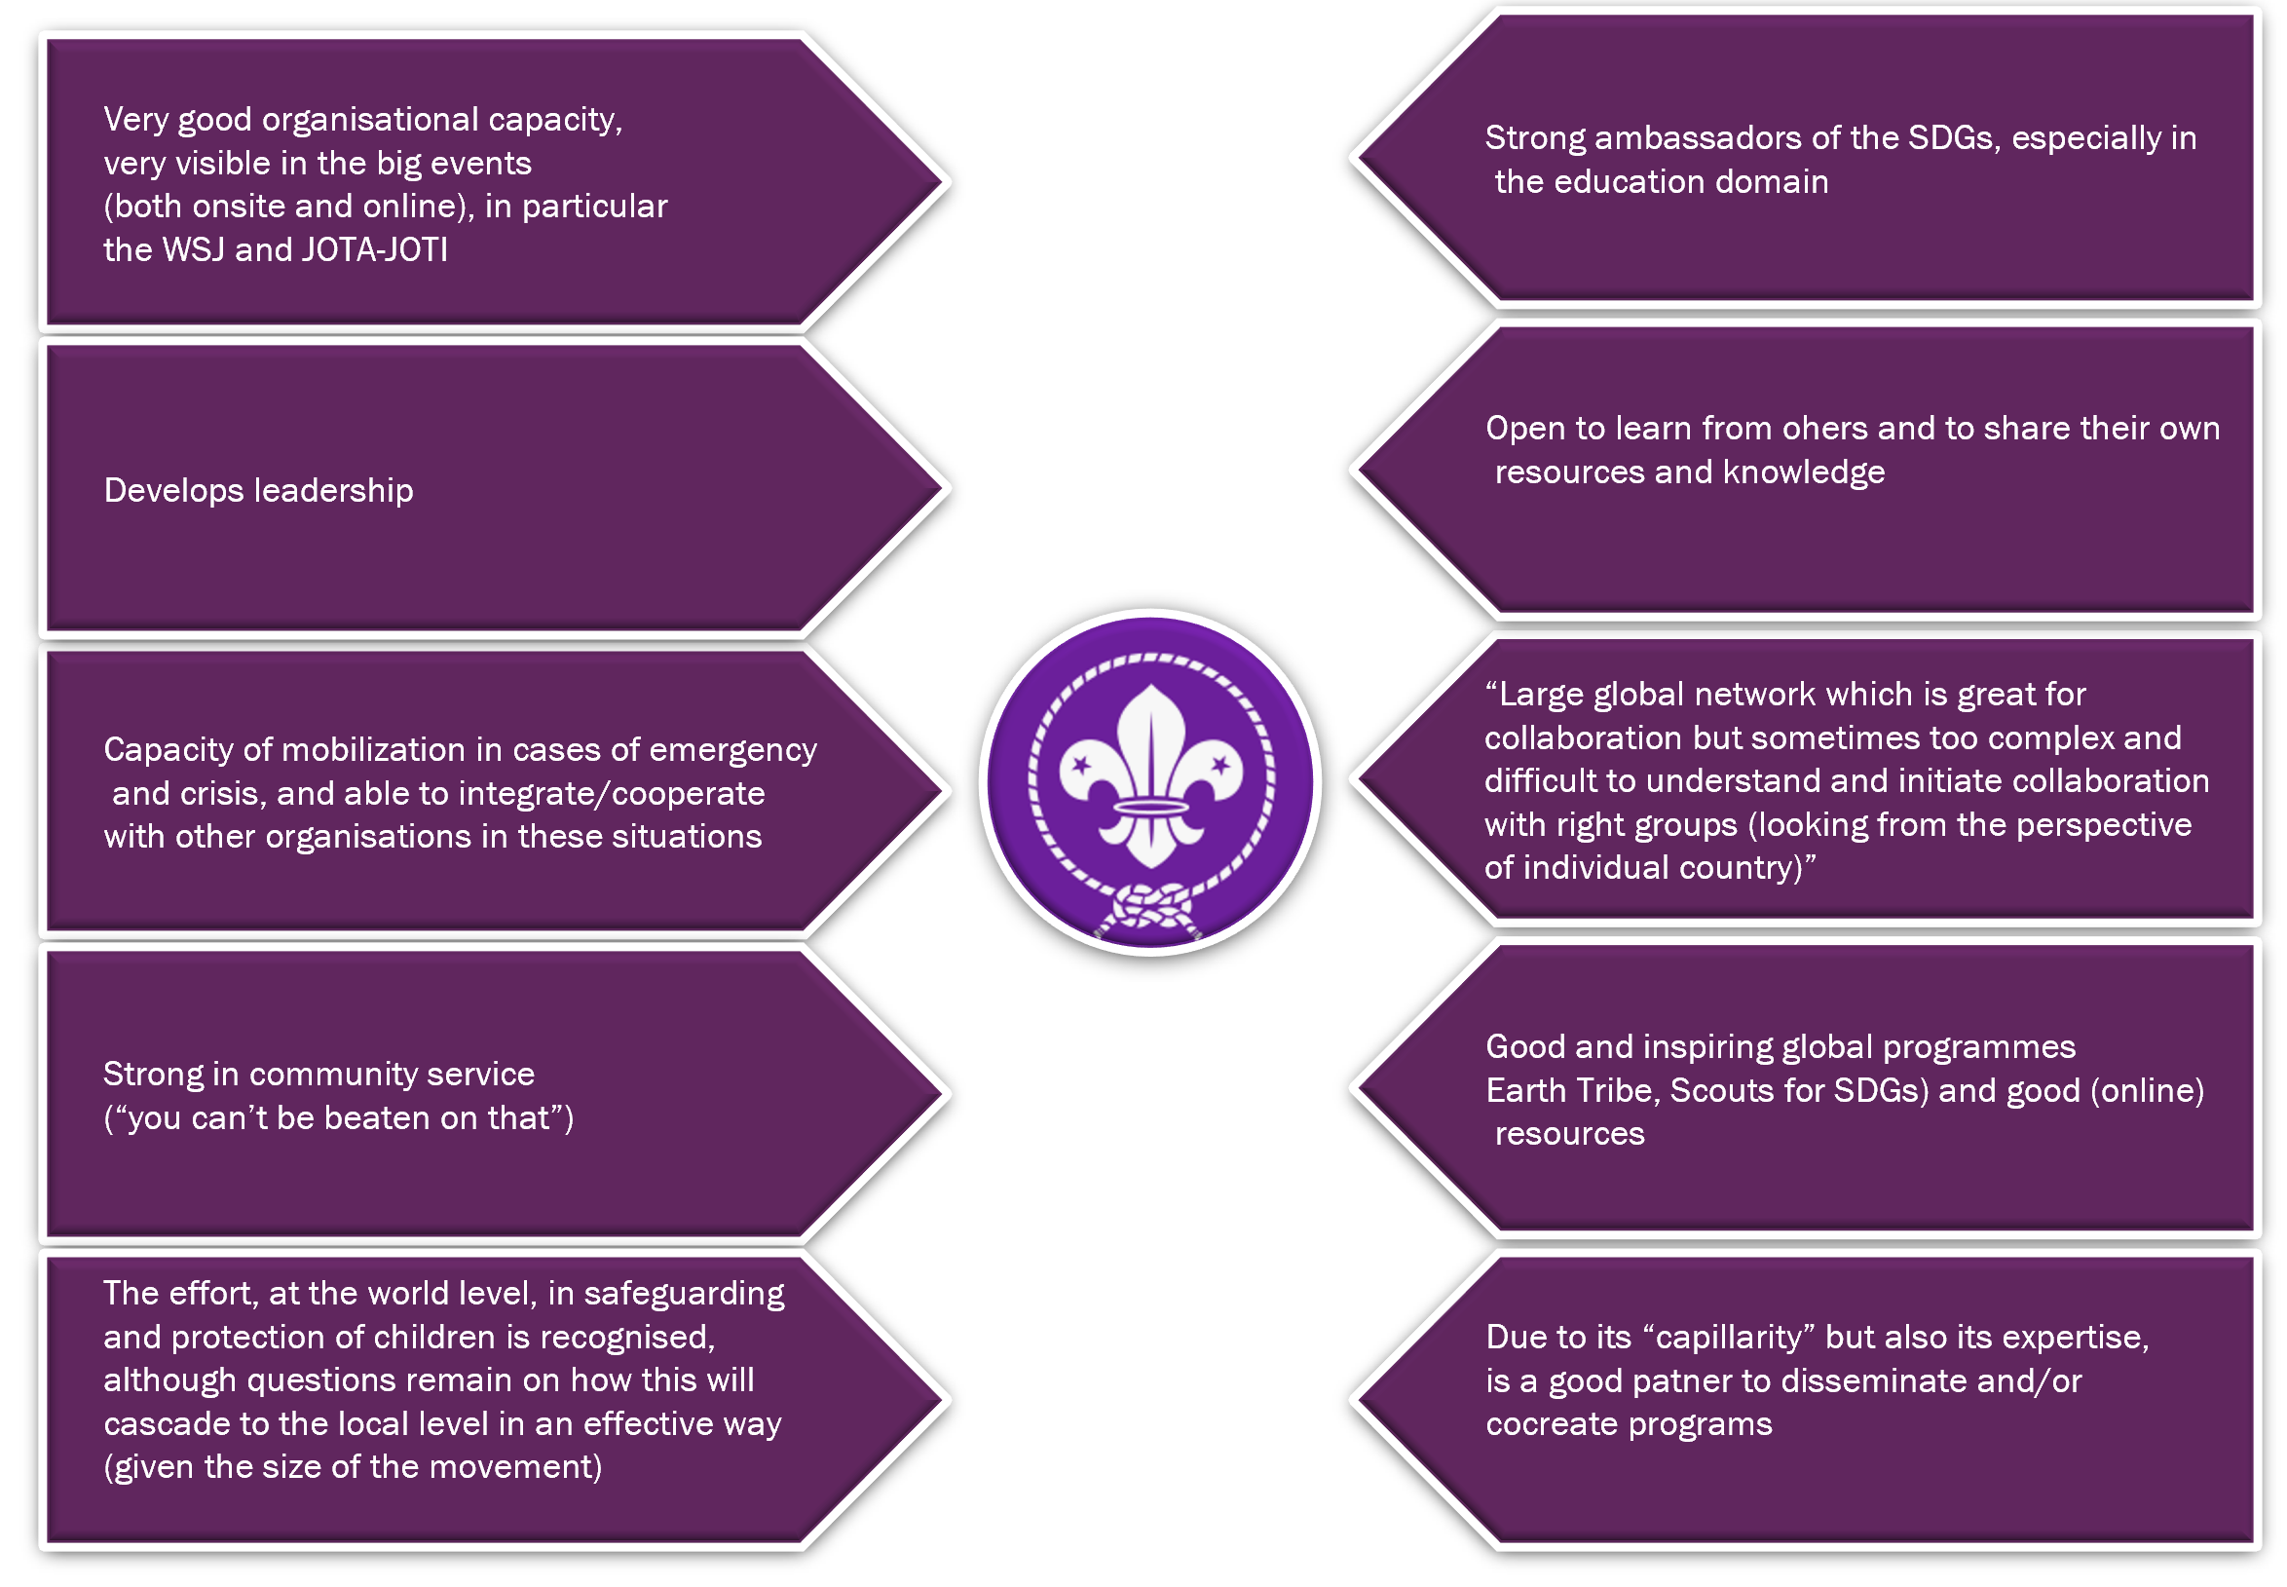
Big six and global partners
how do partners see us?
section 04

Slide 55

how the WSF sees us in 15 years
Doing something completely different and being innovative.
Technology, new ways to live Scouting, going digital.
Staying attractive and relevant. Matching young people aspirations. Better visibility
Young people are getting more responsibilities at a younger age, responsible active citizens.
Bigger numbers on young people involved in decision-making, at all levels.
Scouting is adapting.
NSOs will have an important place in the discussion in the society, in the country. Recognition of Scouting and its social impact, better work on this impact.
Thinking as a global Movement but acting local. Better diversity and inclusion (groups, social classes, marginalized children etc.)
Sustainability of the Movement (members, environment etc.) Scouts for SDGs.
section 04

Slide 56
eyes in the future
05

Slide 57
potential impacts in Scouting of specific trends
a.

Slide 58
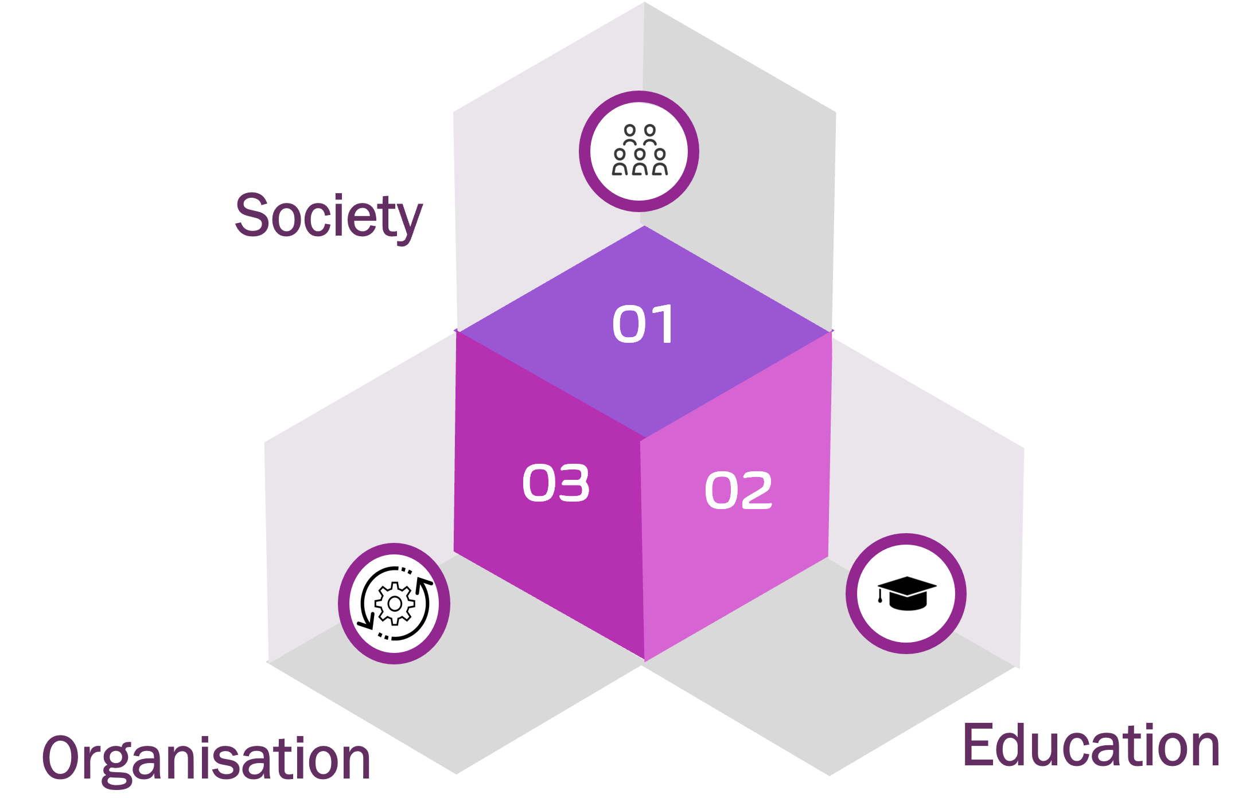
trends & impacts
The identification of a number of trends in the 3 specific domains leads to the exercise of exploring what the impacts will be in Scouting, both at educational level and in terms of organisation and structures. The list below is presented as a starting point for that exercise which can and should be continued throughout the process of creating the new Strategy for Scouting beyond 2024.
section 05

Slide 59
Trends in “Work and Organisations” 1/2
trends & impacts
From the hands to the brain | Scouting as an environment (a sanctuary) where young people can use their hands in practical stuff AND/OR More intellectual and creative challenges in Scouting programmes More educated (young) adults means: more calls for accountability, different types of training, more knowledge and experiences to share and use in the educational action but also in the organization …
Less control, more autonomy around a shared vision (and organisational values) | Reinforce strategic approaches in WOSM and NSOs in this line Cultivate trust and constructive reviews …
Technology, technology, technology (and do we cope with the “thinking machines”?) | Scouting as “refuge” that provides first-hand and direct experiences (the value of nature, human contact and relations…) AND The use of technology in activities, in the running of patrols or units, an in the NSOs structures …
Focus on energies | Programmes based on sustainable development …
Health and well-being become (also) a priority | Programmes more “person(s)-centered” (the young person and the ones around him – the Service dimension) The importance of nature Addressing also mental health Scout/(personal) life balance – less time available from adults? Bigger demands in managing young people different activities outside of scouting (school, sports, leisure…)?
section 05

Slide 60
Trends in “Work and Organisations” 2/2
trends & impacts
Possess less, experience/use more | Less “long-term membership” and more “time-limited (strong) experiences” OR different types of membership NSOs to go on a “resources’ diet” (less bricks and mortar) and enhance partnerships in which they can share and interchange limited resources with others …
Careers as a collection of (professional) meaningful experiences – connection with LLL | Being a scout leader needs to be one meaningful experience; and the life cycle of the adult can be limited …
Organisations: core (formal & stable) + project teams (flexible & innovative) [the ambidextrous organisation] | Embrace flexibility in organisations (requires training of their leaderships) …
Organisations: focus on objectives and results (and less on how the teams achieve them) | Extensive use of “the project” as an educational tool …
Organisations: a multigenerational and multicultural space (several cohorts, with different characteristics, working together and interacting with each other) | The importance of “training” in dialogue and cooperation across generations and cultures; understand “the other” …
section 05

Slide 61
Trends in “Education” 1/2
trends & impacts
Educate people for the unknown → non-cognitive transferable skills (aka 21 st century skills) and LLL being natural | Reinforce the element on 21 st century skills on the Youth Programme: creativity, problem solving, critical thinking, teamwork, communication, conflict resolution Position Scouting externally as one big provider of 21 st century skills Encourage, both in youth and adults, an attitude and practice of “ongoing learning”, adaptability to changes, confidence and agency …
Education for all → overcoming inequalities and gaps (social and economic) | Take Scouting to communities in the “fringes of society” – reach out to the “social peripheries” Economic status can not be an obstacle to be a scout Adopt flexible organisational procedures to meet communities’ realities and practices (can indigenous people cope with our paperwork?) …
Education for each one → learner-centred approach (including care of the different dimensions of the self) | The individual approach in scouting education (back to the basics) – implies o flexibility in implementing the Youth Programme (and not “one size fits all”) o suitable training for adult leaders Ensure a balanced Youth Programme with similar importance being given to physical, intellectual, affective, spiritual, social and character development Youth-shaped activities and projects …
Focus on personal and collective wellbeing | Scouting as a steppingstone for earning your living (now or in the future)? – introducing young people to some hard skills (eg: entrepreneurship, financial literacy, agriculture and gardening,…) Life beyond work: what do you really need? what makes you happy? Life choices (from the daily ones to the long term ones) Contribute for the collective wellbeing like access to health and education, more civic engagement, security, stronger social connections, better environment… …
section 05

Slide 62
Trends in “Education” 2/2
trends & impacts
Learning “on demand”: anytime, anywhere, in any way → free choice and learners’ ownership | Free circulation + recognition (eg: develop a project with scouts from other district/country and progress being recognised “at home”) Online challenges – individual or to be taken by a ad-hoc group Different type(s) of “membership”? (eg: project-based? activity-based?) – what implications? Participation: learning by doing (too) – in the unit, in the scout structures, in the community …
Technology as a powerful enabler | “Hybrid” programmes? Use the social aspect of technologies Technology as a tool (not your life) …
education: focused on competences, anchored on values | “What are you able to DO?” – the learning journey as the acquisition of a series of competencies (most of them with real-life application) The importance of values in a volatile and uncertain world; some non-negotiable? Others depending on geography, age, social context, cultural norms… (should these be changed?) How to build personal values? Relation with the collective ones …
Learning environments: from local to global | Focus on community involvement, social and environmental justice Bigger emphasis on the educational value of the international dimension of Scouting as a vehicle for global citizenship The rights and duties of being a member of the communities …
“It takes a village…” – the many actors in an educational process | Increase dialogue with educational partners (from the local group to the world level) To value (in the personal progression) the achievements made by young people in the environments outside of scouting (family, school, sports…) …
The value of hands-on, real life, learning experiences | “Nature as the field of action, the laboratory, the temple” – reloaded “On-the-job” citizenship – a citizenship that is not only “taught” but experienced in concrete projects with tangible results that grow young people’s confidence The importance of the reviews after the activity – “what did I learn from this?” (individual + group review) Keep the fun and challenging sides of activities Take the most ...

Slide 63
Trends in “Society” 1/2
trends & impacts
Social and family structures will likely continue to change | To value the social and mutual learning aspects of the “communities of adult volunteers” What role and profile for the “adult educator” What type of “adult-young person” relationship? …
Ethnic diversification | Reinforce the intercultural/multicultural learning element Scouting reaching out to different communities and having diverse memberships What role in the migration flows? …
Involvement in democratic life will have less and less influence, which may result in severe “intergenerational conflict”. | Train for democracy in the educational action Increase concrete experiences of intergenerational dialogue and cooperation Develop the sense of “positive activism” and the sense of belonging to civil society Explore different mechanisms in the governance of the organization that enables a more ongoing and generalised participation …
Workers seeking ways to balance their professional and personal lives | What type of commitment will adult educators have? New forms of adult (volunteer) support? More “professional” adult support? Regain the importance of the Patrol Leader and young people autonomy in general? Support young people in “life choices” …
Rcognition of the importance of diversity and inclusion | Membership needs to reflect the social profile of communities rules and regulations need to adapt to different publics Highlight the educational value of a diverse group/association Explore different models of integration: total mix, chartered groups (linked to specific groups based on culture, religion, origin…) …
section 05

Slide 64
Trends in “Society” 2/2
trends & impacts
Family solidarity model is evolving, the traditional place and the role of older people are challenged. | Scouting as a healthy space for dialogue and cooperation between generations (so that young people can use those skills in society) Young people will want to “seat at the table” at the different levels of the movement and the organisation (if they don’t, they may leave) What role for the older people in Scouting, both in the educational setting and governance roles? …
Gender equality will be more and more a norm in developing countries | How to break the “glass ceiling” in governance structures in many NSOs? (even having in mind the cultural realities) Scouting as a healthy and safe space for individuals to flourish, regardless of their gender (but having it in mind) Gender is everybody’s business (including boys and men) Why do we now have NSOs with a majority of girls and women? (a reflection on the programme may be needed) …
Pessimism and distrust | To be a beacon of hope (personal and collective) Value the positives (“the world is getting better, actually”) Value collaborative practices and their results (tell the story) Learn how to cope with frustration and failures …
Religious populations worldwide is projected to be 23 times larger than the growth of the unreligious between 2010 and 2050. | Showcase what Interreligious dialogue can be (see Scouting example in the WSJ) Make religious institutions our partners, instead of alienating them (there is huge potential for growing here) To have coexisting “religious spaces” in Scouting as a normal thing …
Social polarization | Dialogue, dialogue, dialogue To support informed life choices and set personal value system To develop interaction skills: active listening, negotiation, conflict management, consensus building, collective decision-making…
section 05

Slide 65
how do we see Scouting in 15 years?
b.

Slide 66
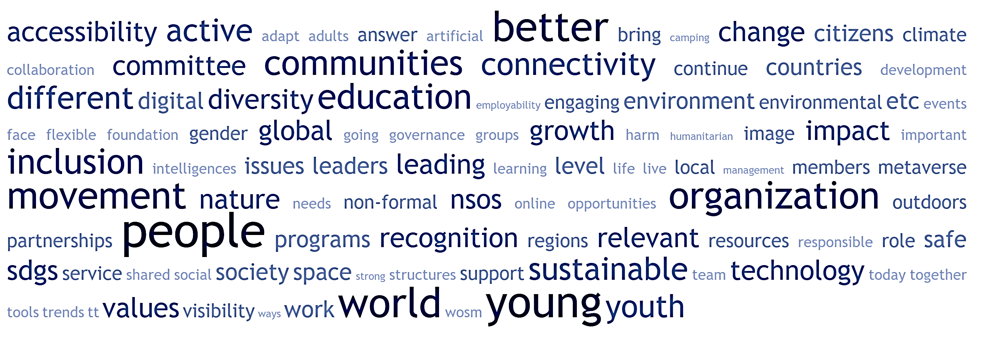
focus group
how do we envision our future?
section 05

Slide 67
how do we envision our future?
Scouting in tune with the megatrends!
A Scouting that responds to new needs and adapts to new contexts.
A stronger and better recognised Scouting.
A Scouting that combines its fundamentals with innovations.
There is a strong convergence between the different focus groups on the question of the future of the Movement.
There is a willingness to continue to develop the Movement, to open up to as many young people as possible and to consider the realities and challenges of the world (health, education, employability, inclusion, environment, technology, etc.). There is an agreement to see Scouting as relevant and useful to young people and society, a Scouting that knows how to take responsibility (safe and caring space) and defend common goods and values (by getting involved in the SDGs, for example). We also have a tension between what should be preserved and what should be introduced; nevertheless, focus groups participants are willing to experiment and integrate innovations into our practices.
section 05

Slide 68
reflexions & questions
061

Slide 69
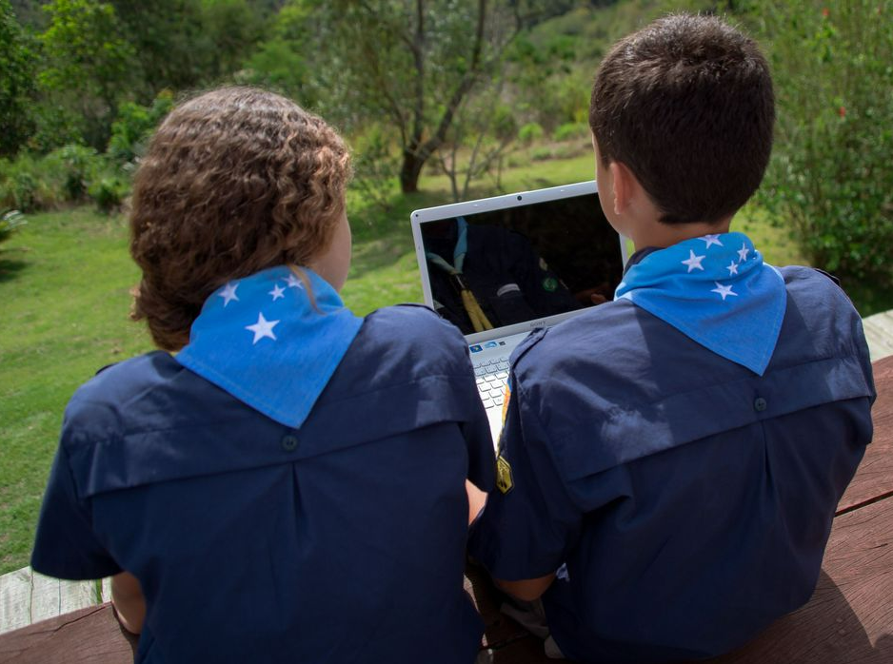
What horizons do we set for Scouting?
reflexions & questions
As a movement, we may need to integrate or consider the challenges and transformations of our societies and analyse the impact of technological developments on educational methods.
What ways to impact the lives of young people and adults?
What adaptations should we make to our activities?
What educational levers should we focus on?
What standards and values should we stand for?
As an organisation, we may want to question ourselves and find a way to reflect on and transform our model in depth.
What skills should we mobilise?
What links and reports we need to nurture?
What funding levers should we activate?
What synergies and with which players in our ecosystems should we build?
section 06

Slide 70
annexes

Slide 71
references
Almeida M, Diogo R. Human enhancement: Genetic engineering and evolution. Evol Med Public Health. 2019 Sep 28;2019(1):183-189. doi: 10.1093/emph/eoz026. PMID: 31620286; PMCID: PMC6788211.
ASDA’A BCW Arab Youth Survey 2021 - The 13th Annual
Arntz, Melanie & Gregory, Terry & Zierahn, Ulrich. (2016). The Risk of Automation for Jobs in OECD Countries: A Comparative Analysis.
Black Rock (2022), “Megatrends – Insights on the forces shaping our future”, Feb 2022 https://www.blackrock.com/hk/en/literature/brochure/megatrends-insights-hk-en.pdf
CSIRO (2022) Our Futur World ; https://www.csiro.au/en/research/technology-space/data/Our-Future-World
Cobo Romaní, C.; Moravec, J. W. (2011). Aprendizaje Invisible. Hacia una nueva ecologia de la educación. Collecció Transmedia XXI. Laboratori de Mitjans Interactius / Publicacions i Edicions de la Universitat de Barcelona. Barcelona
Dataportal - Digital 2020: Global Digital Overview https://dataportal.com/reports/
ESPAS (2019) “Global trends to 2030” https://ec.europa.eu/assets/epsc/pages/espas/index.html
European Parliament – Desk Research – European Youth in 2021 Youth in Europe 2021 (europa.eu)
EY (2020), “Megatrends 2020 and beyond” https://www.ey.com/en_gl/megatrends
Feijoo, J. P. (2011). People and Knowledge management in organizations: challenges of the next decades. JANUS. NET e-journal of International Relations, 93-113.
Frey, C. and Osborne, M. (2013) The Future of Employment: How Susceptible Are Jobs to Computerisation? Working Paper, University of Oxford, Oxford.
Ichikowitz Family Foundation - IFF (ichikowitzfoundation.com) - AFRICAN YOUTH SURVEY 2022
KPMG International - Future State 2030- https://kpmg.com/xx/en/home/insights/2015/03/future-state-2030.html
Lee. T. Markowitz, E. Howe. P et al. Predictors of public climate change awareness and risk perception around the world. Nature Clim Change 5. 1014-1020 (2015)
McKinsey Global Institute (2021) - Defining the skills citizens will need in the future world of work - https://www.mckinsey.com/industries/public-and-social-sector/our-insights/defining-the-skills-citizens-will-need-in-the-future-world-of-work
Moravec, J. W. (Ed.). (2019). Emerging education futures: Experiences and visions from the field. Education Futures LLC.
National Intelligence Council’s - Global Trends report 2040 ; https://www.dni.gov/index.php/gt2040-home
Pew Research Center - The Future of World Religions: Population Growth Projections, 2010-2050 – https://www.pewresearch.org/religion/2015/04/02/religious-projections-2010-2050
OECD (2022), Trends Shaping Education 2022, OECD Publishing, Paris, https://doi.org/10.1787/6ae8771a-en
OECD (2018). The future of education and skills: Education 2030.
Project Management Institut –Global Megatrends 2022 ; https://www.pmi.org/learning/thought-leadership/megatrends/
Saperstein, E. Post-pandemic citizenship: The next phase of global citizenship education. Prospects (2022).
Trend Compendium 2050: Megatrends shaping the coming decades | Roland Berger
Ublishing. UNESCO. (2022). Reimagining our futures together: A new social contract for education. UN.
section 06

Slide 72
references
Future Learn (2022), The Future of Learning report 2022, https://www.futurelearn.com/info/thefutureoflearning
UNDP – UNRISD, (2017), Global Trends: Challenges and Opportunities in the Implementation of the SDGs | United Nations Development Programme (undp.org)
UNFCCC secretariat (UN Climate Change) : Secretary-General's Statement on the Conclusion of the UN Climate Change Conference COP26 | UNFCCC
United Nations, Department of Economic and Social Affairs, Population Division (2022). World Population Prospects 2022, Data Sources. UN DESA/POP/2022/DC/NO. 9.
United Nations Volunteers (UNV) programme (2021). 2022 State of the World’s Volunteerism Report. Building equal and inclusive societies. Bonn
University of People - The Growing Importance of Technology in Education ; https://www.uopeople.edu/blog/the-growing-importance-of-technology-in-education/
World Bank group ; https://openknowledge.worldbank.org)
World Bank & UNICEF (2016). Education 2030: Incheon declaration and framework for action: towards inclusive and equitable quality education and lifelong learning for all.
World Economic Forum ; Billions of people lack internet access during the coronavirus crisis | World Economic Forum (weforum.org)
World Economic Forum ; We asked young people what changes they want for the future. Here's what they said | World Economic Forum (weforum.org
World Meteorological Organization, ‘July sees extreme weather with high impacts’, 1 July 2018, available at https://public.wmo.int/en/media/news/july-sees-extreme-weather-high-impacts
WOSM (2020 census)
section 06

Slide 73
Team
Andy
Cassandre
Irem
João
Pauline
Saâd
thank you

